Slide 1


Leonardo Aldecocea
02/08/2024
https://github.com/Lalde004/Space_Y_Final_Project.git

Slide 2

Outline
Executive Summary (3)
Introduction (4)
Methodology (6)
Results
Conclusion
Appendix

Slide 3
Executive Summary
Methodology
Data preprocessing and feature engineering
Split data into training and test sets
Applied four machine learning models:
Logistic Regression
Support Vector Machine (SVM)
Decision Tree
K-Nearest Neighbors (KNN)
Results
Three models performed equally well (83.333% accuracy): linear regression, SVM, and KNN

Slide 4
Introduction
Project Background and Context:
SpaceX's Falcon 9 rocket launches are revolutionizing the space industry with lower-cost space travel.
The ability to reuse the first stage of the Falcon 9 rocket is key to SpaceX's cost advantage.
Predicting the success of first stage landings is crucial for estimating launch costs.
Competing launch companies need to understand factors influencing landing success to remain competitive.
Key Problems to Address:
Can we accurately predict the success of Falcon 9 first stage landings?
What are the most important factors influencing the success of these landings?
How do different launch parameters (e.g., payload mass, orbit type, launch site) affect landing success probability?
Can we develop a model that helps estimate the cost of a launch for competing companies?
How can we use historical launch data to inform future launch strategies and improve success rates?

Slide 5

Section 1

Slide 6
Methodology
Data Collection:
Gathered SpaceX launch data from public API
Scraped additional information from SpaceX website
Data Wrangling:
Cleaned and structured raw data
Handled missing values and outliers
Standardized data formats
Exploratory Data Analysis (EDA):
Used SQL queries for initial data exploration
Created visualizations to identify patterns and relationships
Analyzed correlations between variables
Interactive Visual Analytics:
Developed interactive maps using Folium to visualize launch sites
Created dynamic dashboards with Plotly Dash for data exploration
Predictive Analysis:
Prepared data for machine learning (feature selection, encoding)
Split data into training and test sets
Applied classification models: Logistic Regression, SVM, Decision Tree, KNN

Slide 7
Data Collection
Collection:
Primary Sources, API data retrieval, Web Scraping, Data Integration
Flowchart:
[SpaceX API] → [Data Extraction] → [JSON Storage] ↓ [SpaceX Website] → [Web Scraping] → [HTML Parsing] ↓ [Data Integration] → [Unified Dataset]

Slide 8
Data Collection – SpaceX API
Process:
Identified SpaceX API endpoint for launch data
Configured request parameters (e.g., limit, offset)
Sent GET requests to retrieve launch records
Parsed JSON responses to extract launch details
Stored data in Pandas DataFrame for analysis
Cleaned and preprocessed the collected data
Space_Y_Final_Project/jupyter-labs-spacex-data-collection-api.ipynb at main · Lalde004/Space_Y_Final_Project (github.com)
[Define API Endpoint] → [Set Request Parameters] ↓ [Send GET Request] → [Receive JSON Response] ↓ [Parse JSON Data] → [Extract Relevant Information] ↓ [Store in DataFrame] → [Clean and Preprocess Data]

Slide 9
Data Collection - Scraping
Process:
Identified SpaceX website pages with relevant launch data
Sent HTTP requests to target URLs
Retrieved HTML content of the web pages
Used BeautifulSoup to parse HTML structure
Located specific HTML elements containing desired information
Extracted data from identified elements
Structured extracted data into a usable format
Stored scraped data in a Pandas DataFrame for further analysis
Space_Y_Final_Project/jupyter-labs-webscraping.ipynb at main · Lalde004/Space_Y_Final_Project (github.com)
[Identify Target URL] → [Send HTTP Request] ↓ [Receive HTML Content] → [Parse HTML with BeautifulSoup] ↓ [Locate Relevant Elements] → [Extract Data] ↓ [Structure Extracted Data] → [Store in DataFrame]

Slide 10
Data Wrangling
Flowchart:
[Raw Data] → [Remove Duplicates] ↓ [Handle Missing Values] → [Convert Data Types] ↓ [Feature Engineering] → [Standardize Formats] ↓ [Outlier Detection/Handling] → [Merge Datasets] ↓ [Final Cleaned Dataset]
Process
Imported raw data from API and web scraping sources
Removed duplicate entries
Identified and handled missing values (imputation/removal)
Converted data types for consistency (e.g., dates, numerical values)
Standardized formats (e.g., units of measurement)
Detected and addressed outliers
Space_Y_Final_Project/labs-jupyter-spacex-Data wrangling.ipynb at main · Lalde004/Space_Y_Final_Project (github.com)

Slide 11
EDA with Data Visualization
Summary of Charts and Their Purpose:
Bar Charts:
Used to compare launch success rates across different sites
Visualized the distribution of booster versions
Pie Charts:
Displayed the proportion of successful vs. failed launches
Showed the distribution of orbits for all launches
Scatter Plots:
Explored relationship between payload mass and launch success
Investigated correlation between flight number and launch outcome
Line Graphs:
Tracked launch success rate over time
Visualized trends in payload mass across years
Box Plots:
Compared payload mass distributions for different orbits
Identified outliers in flight durations
Heatmaps:
Displayed correlation matrix of numerical features
Visualized launch success rates by month and year
Space_Y_Final_Project/edadataviz.ipynb at main · Lalde004/Space_Y_Final_Project (github.com)

Slide 12
EDA with SQL
Basic Data Exploration (SELECT, COUNT, DISTINCT)
Launch Success Analysis (COUNT, GROUP BY, WHERE, HAVING)
Payload Analysis (AVG, MAX, MIN, CASE)
Temporal Analysis (EXTRACT, COUNT, GROUP BY, WHERE)
Booster Analysis (JOIN, COUNT, GROUP BY, WHERE)
Complex Queries (subqueries, CTEs, Window functions)
Data Aggregation (SUM, AVG, ROLLUP)
Space_Y_Final_Project/jupyter-labs-eda-sql-coursera_sqllite.ipynb at main · Lalde004/Space_Y_Final_Project (github.com)

Slide 13
Build an Interactive Map with Folium
Markers:
Added for each launch site location
Displayed site name and coordinates on click Purpose: To precisely indicate launch site locations
Circles:
Created around each launch site
Radius proportional to launch success rate Purpose: To visually represent the relative success of each site
Polylines:
Connected launch sites to their respective landing zones
Color-coded based on landing success rate Purpose: To illustrate the trajectory and success of first stage returns
Heatmap Layer:
Showed density of launches across geographical areas Purpose: To highlight areas with high launch activity
Choropleth Layer:
Colored states/countries based on number of launches Purpose: To display the distribution of launches across regions
Custom Icons:
Different colors for successful vs. failed launches Purpose: To enhance visual distinction between launch outcomes
Popup Windows:
Added to markers with detailed site information
Space_Y_Final_Project/lab_jupyter_launch_site_location.ipynb at main · Lalde004/Space_Y_Final_Project (github.com)

Slide 14
Build a Dashboard with Plotly Dash
Plots/Graphs:
Pie Chart: Launch success rate by site
Scatter Plot: Payload mass vs. launch outcome
Bar Chart: Launch success count by year
Line Graph: Launch success rate over time
Interactions:
Dropdown menu: Select launch site
Range Slider: Filter payload mass range
Radio Buttons: Choose orbit type
Date Picker: Select date range for analysis
Space_Y_Final_Project/spacex_records.py at main · Lalde004/Space_Y_Final_Project (github.com)

Slide 15
Predictive Analysis (Classification)
Flowchart:
[Preprocessed Data] → [Feature Selection] ↓ [Train-Test Split] → [Model Training] ↓ [Hyperparameter Tuning] → [Cross-Validation] ↓ [Model Evaluation] → [Model Comparison] ↓ [Select Best Model] → [Final Testing]
Process:
Selected relevant features based on EDA insights
Split data into training and testing sets (80-20 split)
Trained multiple models:
Logistic Regression
Support Vector Machine (SVM)
Decision Tree
K-Nearest Neighbors (KNN)
Performed hyperparameter tuning using GridSearchCV
Conducted 10-fold cross-validation for each model
Evaluated models using accuracy
Compared model performances
Space_Y_Final_Project/SpaceX_Machine Learning Prediction_Part_5 (1).ipynb at main · Lalde004/Space_Y_Final_Project (github.com)

Slide 16
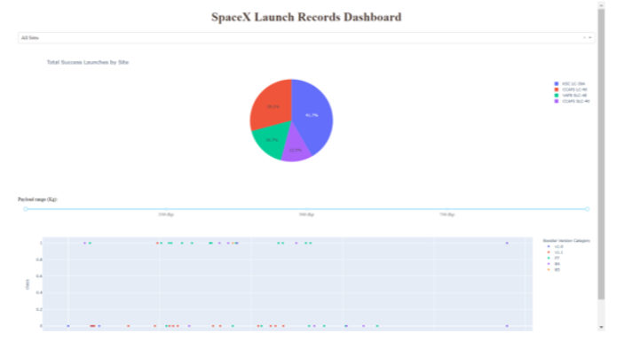
Results
PREVIEW OF PLOTLY DASHBOARD

Slide 17

Section 2

Slide 18
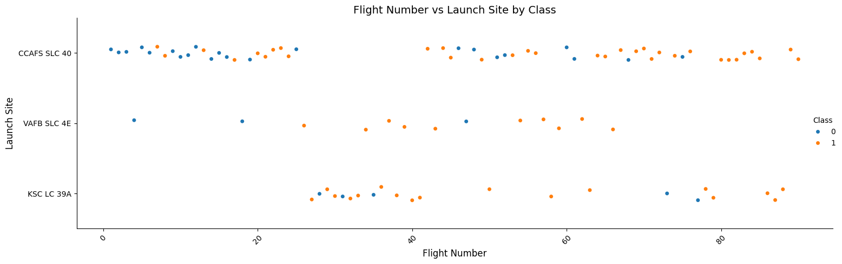
Flight Number vs. Launch Site
Show a scatter plot of Flight Number vs. Launch Site
Show the screenshot of the scatter plot with explanations

Slide 19
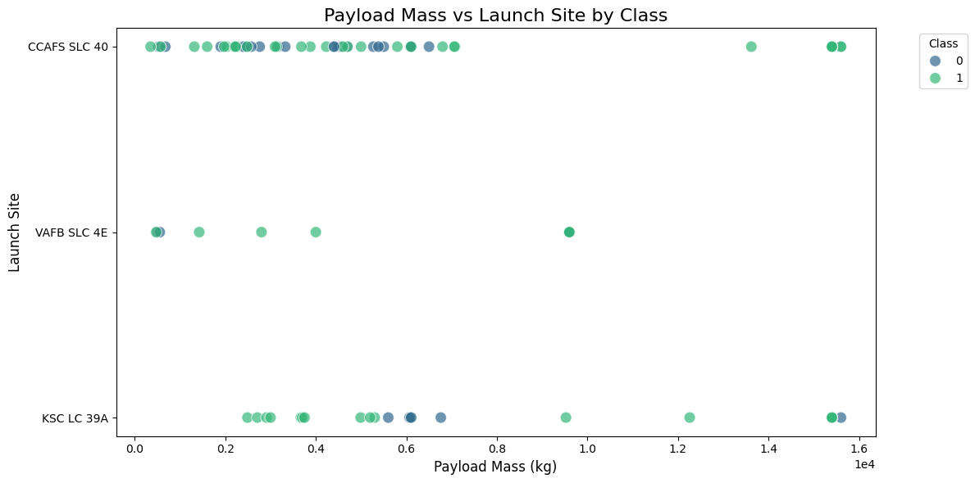
Payload vs. Launch Site

Slide 20
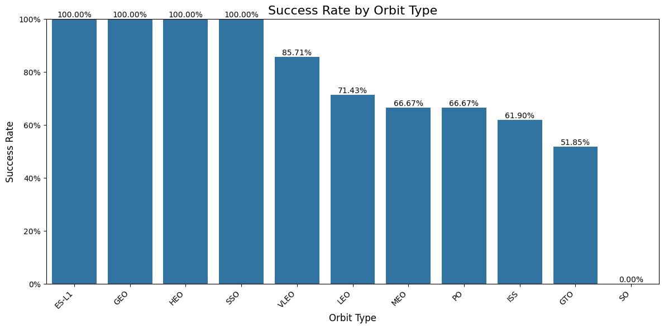
Success Rate vs. Orbit Type
Show a bar chart for the success rate of each orbit type
Show the screenshot of the scatter plot with explanations

Slide 21
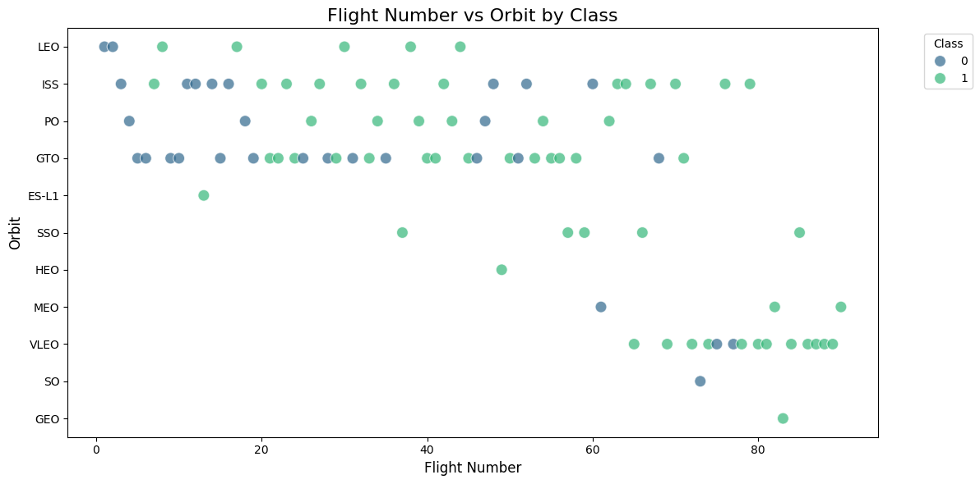
Flight Number vs. Orbit Type
Show a scatter point of Flight number vs. Orbit type
Show the screenshot of the scatter plot with explanations

Slide 22
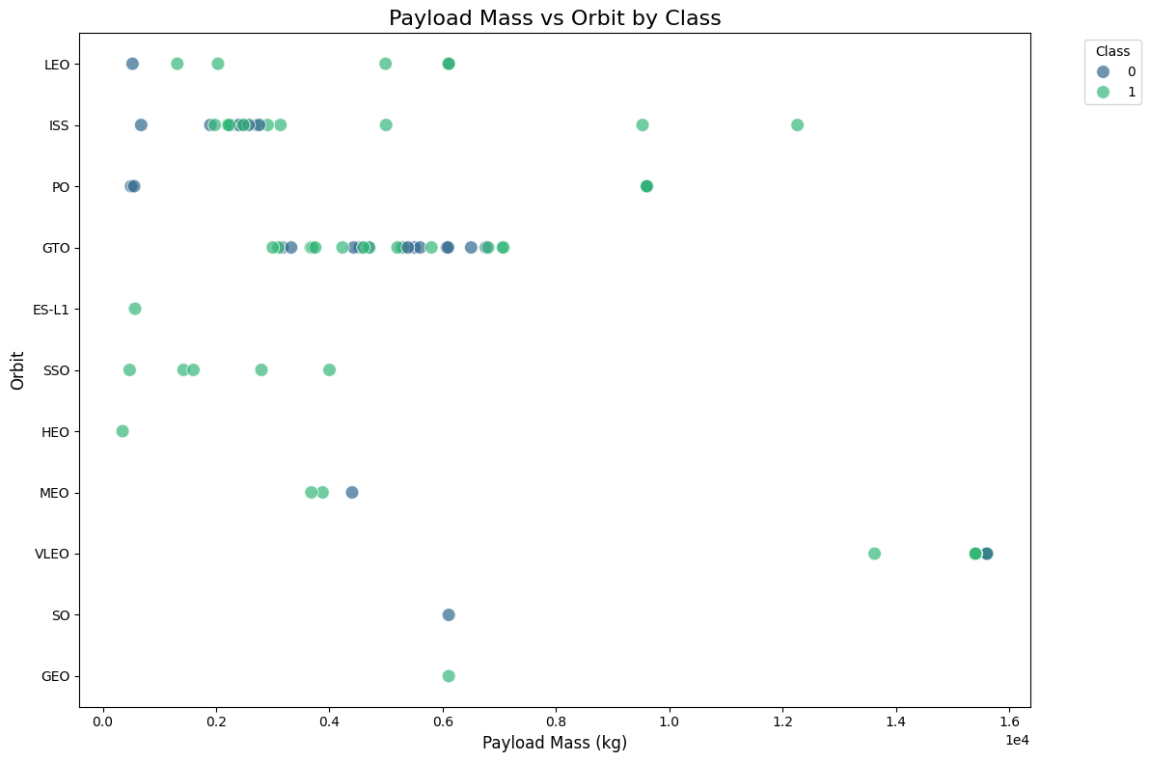
Payload vs. Orbit Type
Show a scatter point of payload vs. orbit type
Show the screenshot of the scatter plot with explanations

Slide 23
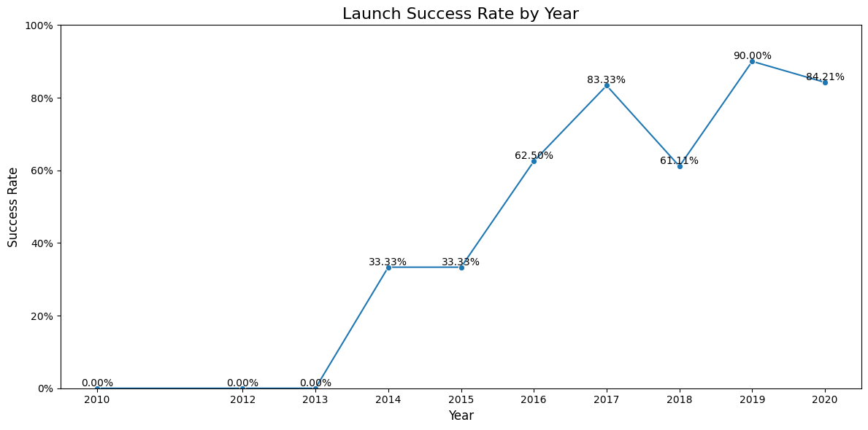
Launch Success Yearly Trend
Show a line chart of yearly average success rate
Show the screenshot of the scatter plot with explanations

Slide 24
All Launch Site Names
SELECT DISTINCT LaunchSite FROM SpaceXLaunchData ORDER BY LaunchSite;
LAUNCH SITES
CCAFS LC-40: Cape Canaveral Air Force Station, Launch Complex 40
CCAFS SLC-40: Cape Canaveral Air Force Station, Space Launch Complex 40
KSC LC-39A: Kennedy Space Center, Launch Complex 39A
VAFB SLC-4E: Vandenberg Air Force Base, Space Launch Complex 4E

Slide 25
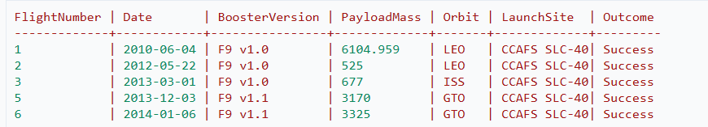
Launch Site Names Begin with 'CCA'
SELECT * FROM SpaceXLaunchData WHERE LaunchSite LIKE 'CCA%' LIMIT 5;

Slide 26
Total Payload Mass
SELECT SUM(PayloadMass) AS TotalNASAPayload FROM SpaceXLaunchData WHERE Customer = 'NASA' OR Customer LIKE '%NASA%’;
Total NASA Payload: 45,596.0 kg
Key points about this result:
The query sums up the PayloadMass for all launches where the Customer is either exactly 'NASA' or contains 'NASA' in its name (to catch variations like 'NASA/NOAA').
The total of 45,596.0 kg represents the cumulative mass of all payloads SpaceX has launched for NASA missions.

Slide 27
Average Payload Mass by F9 v1.1
SELECT AVG(PayloadMass) AS AveragePayloadMass FROM SpaceXLaunchData WHERE BoosterVersion = 'F9 v1.1’;
Average Payload Mass for F9 v1.1: 2,534.67 kg
Key points about this result:
The Falcon 9 v1.1 was an upgraded version of the original Falcon 9, introduced in 2013.
The average payload of 2,534.67 kg (assuming the unit is kilograms) represents the typical mass of payloads this version of the Falcon 9 carried.

Slide 28
First Successful Ground Landing Date
SELECT Date, LaunchSite, LandingOutcome FROM SpaceXLaunchData WHERE LandingOutcome = 'Success (ground pad)' ORDER BY Date ASC LIMIT 1;
First Successful Ground Pad Landing:
Date: December 22, 2015
Launch Site: CCAFS SLC-40 (Cape Canaveral Air Force Station, Space Launch Complex 40)
Landing Outcome: Success (ground pad)
Key points about this result:
This date marks a significant milestone in SpaceX's reusability efforts. It was the first time they successfully landed the first stage of a Falcon 9 rocket on solid ground after a mission.

Slide 29
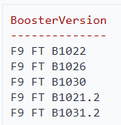
Successful Drone Ship Landing with Payload between 4000 and 6000
SELECT DISTINCT BoosterVersion FROM SpaceXLaunchData WHERE LandingOutcome = 'Success (drone ship)' AND PayloadMass > 4000 AND PayloadMass < 6000 ORDER BY BoosterVersion;
Five distinct booster versions met these criteria.
All boosters are variants of the Falcon 9 Full Thrust (FT) version.
The ".2" suffix on some boosters (e.g., B1021.2) indicates that these were reused boosters on their second flight.

Slide 30
Total Number of Successful and Failure Mission Outcomes
SELECT SUM(CASE WHEN MissionOutcome = 'Success' THEN 1 ELSE 0 END) AS SuccessfulMissions, SUM(CASE WHEN MissionOutcome = 'Failure' THEN 1 ELSE 0 END) AS FailedMissions FROM SpaceXLaunchData;
Successful Missions: 101
Failed Missions: 1

Slide 31
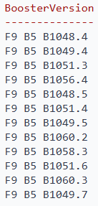
Boosters Carried Maximum Payload
SELECT DISTINCT BoosterVersion FROM SpaceXLaunchData WHERE PayloadMass = (SELECT MAX(PayloadMass) FROM SpaceXLaunchData);
Multiple boosters have carried the maximum payload mass.
All of these boosters are variants of the Falcon 9 Block 5 (F9 B5) version.

Slide 32
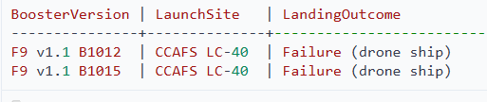
2015 Launch Records
SELECT BoosterVersion, LaunchSite, LandingOutcome FROM SpaceXLaunchData WHERE YEAR(Date) = 2015 AND LandingOutcome LIKE 'Failure (drone ship)%’;
Two failed drone ship landing attempts in 2015:
a. First Attempt:
Booster Version: F9 v1.1 B1012
Launch Site: CCAFS LC-40 (Cape Canaveral Air Force Station, Launch Complex 40)
Outcome: Failure (drone ship)
b. Second Attempt:
Booster Version: F9 v1.1 B1015
Launch Site: CCAFS LC-40
Outcome: Failure (drone ship)

Slide 33
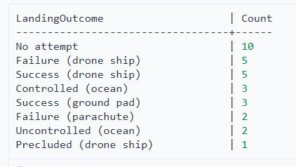
Rank Landing Outcomes Between 2010-06-04 and 2017-03-20
SELECT LandingOutcome, COUNT(*) as Count FROM SpaceXLaunchData WHERE Date BETWEEN '2010-06-04' AND '2017-03-20' GROUP BY LandingOutcome ORDER BY Count DESC;
No attempt (10): The most common outcome, likely for earlier missions or those where landing wasn't planned.
Failure (drone ship) (5): Unsuccessful attempts to land on an autonomous spaceport drone ship.

Slide 34

Section 3

Slide 35
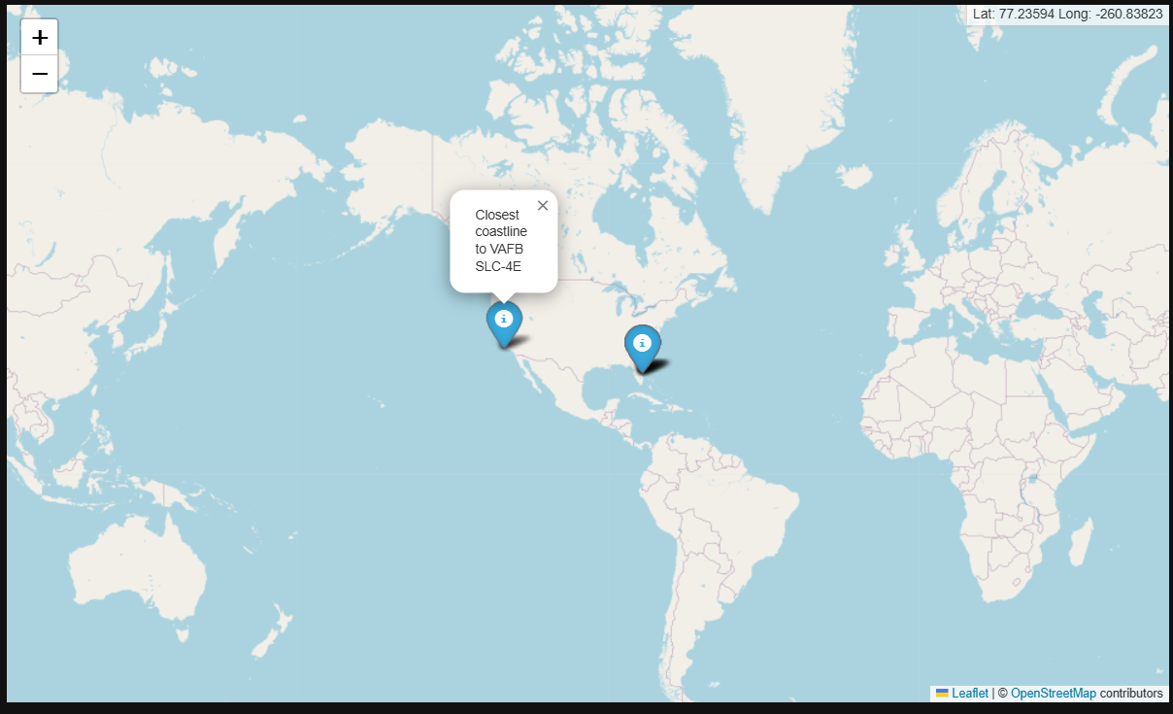
<Folium Map Screenshot 1>
Global Map displaying SpaceX launching locations located in the United States

Slide 36
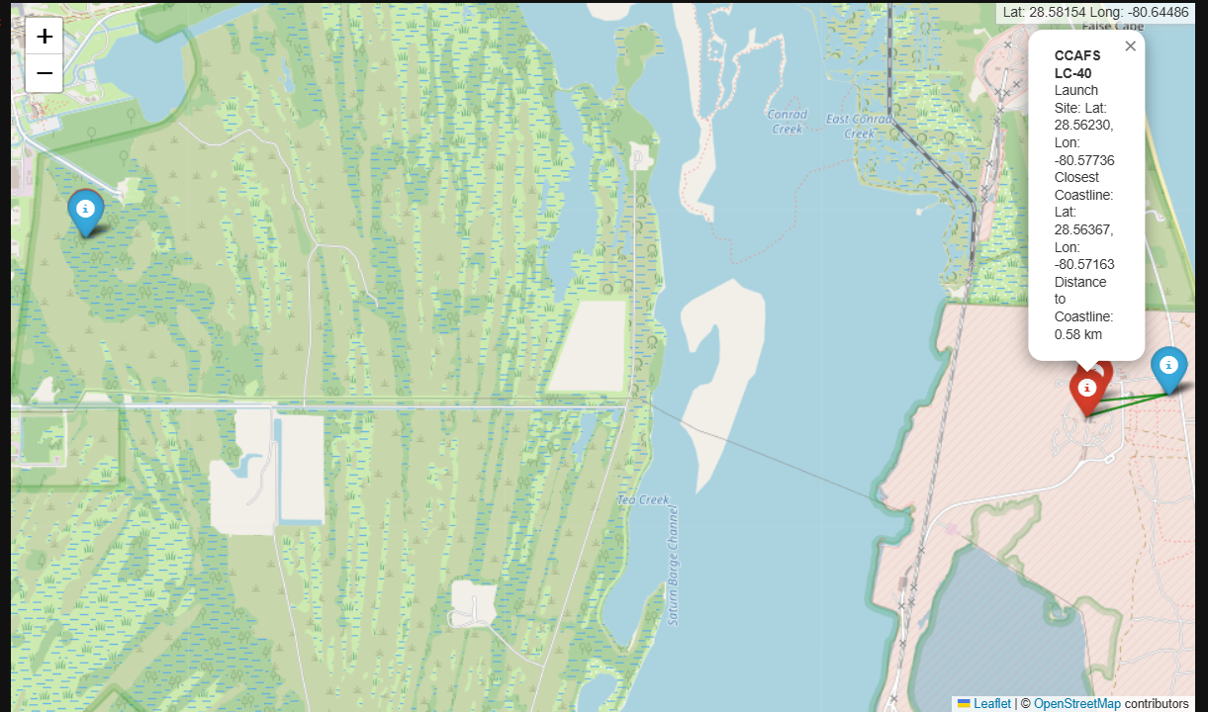
<Folium Map Screenshot 2>
Map displaying red (failed) markers and blue (success) markers

Slide 37
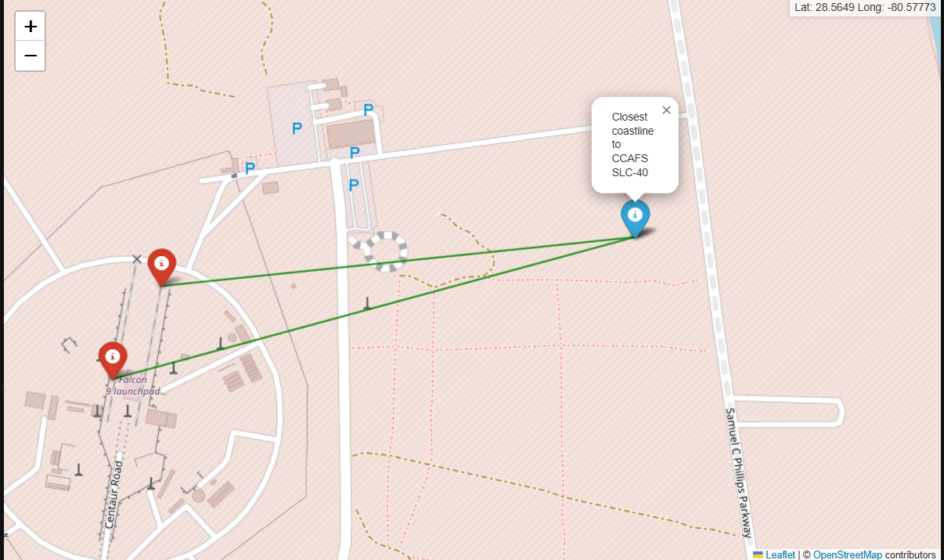
<Folium Map Screenshot 3>
Detailed map displaying roads, railroads, etc. and nearest coastline

Slide 38

Section 4

Slide 39
<Dashboard Screenshot 1>
Replace <Dashboard screenshot 1> title with an appropriate title
Show the screenshot of launch success count for all sites, in a piechart
Explain the important elements and findings on the screenshot

Slide 40
<Dashboard Screenshot 2>
Replace <Dashboard screenshot 2> title with an appropriate title
Show the screenshot of the piechart for the launch site with highest launch success ratio
Explain the important elements and findings on the screenshot

Slide 41
<Dashboard Screenshot 3>
Replace <Dashboard screenshot 3> title with an appropriate title
Show screenshots of Payload vs. Launch Outcome scatter plot for all sites, with different payload selected in the range slider
Explain the important elements and findings on the screenshot, such as which payload range or booster version have the largest success rate, etc.

Slide 42

Section 5

Slide 43
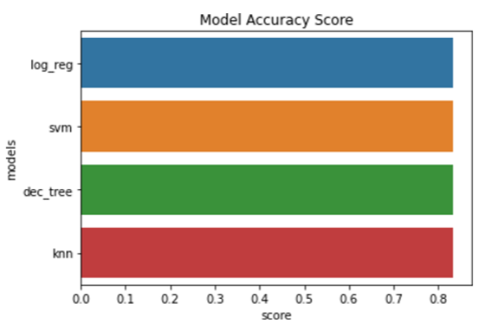
Classification Accuracy
All four models displayed similar accuracy at 83.33% accuracy.
A larger sample size is needed.

Slide 44
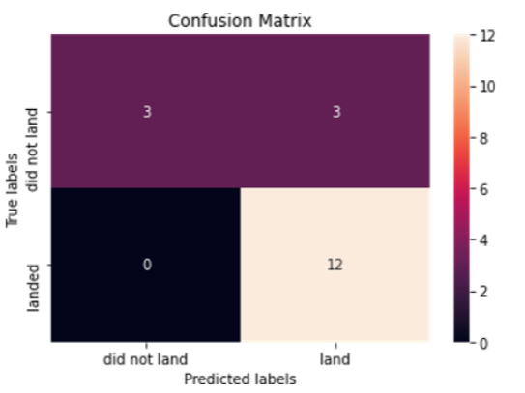
Confusion Matrix
All models displayed similar accuracy.
The small sample size (18) leads to over-prediction of success.

Slide 45
Conclusions
Based on the analyses and queries we've performed, here are four key conclusions we can draw about SpaceX's launch operations:
1. High Success Rate and Rapid Evolution: SpaceX has demonstrated an impressive success rate in its missions, with 101 successful launches out of 102 total missions in our dataset.
2. Mastery of Reusability: The data shows a clear progression in SpaceX's reusability efforts. From early failures in drone ship landings to consistent successes with both drone ship and ground pad landings, SpaceX has mastered the art of recovering and reusing boosters. This is evidenced by boosters flying up to seven times (e.g., F9 B5 B1049.7)
3. Diverse Launch Capabilities: SpaceX has demonstrated the ability to handle a wide range of payload masses (from under 1000 kg to over 15,000 kg) and serve various orbits (LEO, GTO, ISS, etc.). The consistent performance of the Falcon 9 Block 5 across multiple launches and its ability to carry maximum payloads even after several reuses highlight SpaceX's versatility in meeting diverse customer needs.
4. Strategic Launch Site Utilization: The analysis of launch sites reveals SpaceX's strategic approach to space access. With primary sites on both the East Coast (Cape Canaveral, Kennedy Space Center) and West Coast (Vandenberg), SpaceX can efficiently reach a variety of orbits.

Slide 46


